Slide 1
Fables
LRA 3.1
Describe the structural differences of various imaginative forms of literature, including fantasies, fables, myths, legends, and fairy tales.
Mrs. Vogel
Cinnamon Elem.
4th Grade

Slide 2
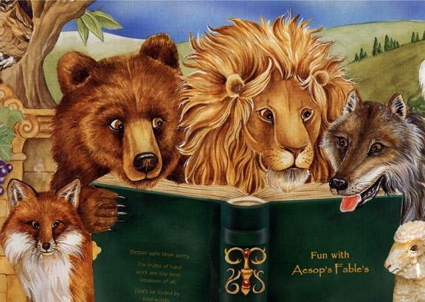
What is a Fable?
Fables are stories intended to teach a lesson, and animals often speak and act like human beings.
LRA 3.1

Slide 3
Elements to Remember
ANIMALS are usually the main characters
The plot and characters are SIMPLE
Stories teach a MORAL or LESSON
SETTING is common and nonspecific
Author uses PERSONIFICATION
LRA 3.1

Slide 4
What is Personification?
In simple terms, its making animals or objects seem like real people, with real human feelings and emotions.
Personification =
Person
LRA 3.5

Slide 5
Compare & Contrast
Fables
Folktales
RC 2.5

Slide 6
Compare & Contrast
Fables
Folktales
Common People or Animals
Animals
RC 2.5

Slide 7
Compare & Contrast
Fables
Folktales
Exaggeration
Personification
RC 2.5

Slide 8
Compare & Contrast
Fables
Folktales
Sets of 3 events
Very Short Tales
RC 2.5

Slide 9
Compare & Contrast
Fables
Folktales
Happy Endings
Moral or Lesson
RC 2.5

Slide 10
Compare & Contrast
Fables
Folktales
Happy Endings
Sets of 3 events
Exaggeration
Common People or Animals
Moral or Lesson
Very Short Tales
Personification
Animals
RC 2.5

Slide 11
Aesop
Aesop was a slave that lived about 550 BC.
He is famous for his fables.
Legend says he was granted freedom from his master because he enjoyed the stories so much.
Interesting, Aesop didn’t write down any of his fables. But after his death, they were written down for him.

Slide 12

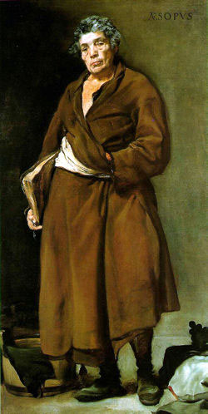
Aesop
(Painting, c. 1638, by Diego Velasquez.
Museo del Prado, Madrid)

Slide 13
Examples
The Grasshopper and the Ants (Bug’s Life)
The Tortoise and the Hare
The Lion and the Mouse

Slide 14

Author’s Purpose
These stories were brief, and told to adults for entertainment.
These stories were passed down from generation to generation.
RC 2.2

Slide 15
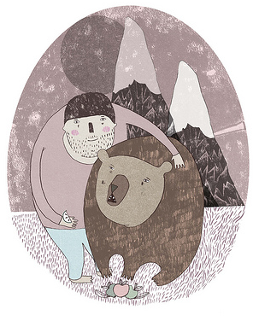
The Bear and the Gardener
Hyperlink

Slide 16
A gardener, who lived alone, set out one day to seek a friend who would be a suitable companion. He had not gone far when he met a Bear, whom he invited to come and live with him. The Bear was a very silly one, who was also discontented with living alone, so he went home with the gardener very willingly.

Slide 17
The gardener provided all the food, and the only service he required of the Bear was to keep the flies off his face while he slept in the shade. One day, a fly insisted upon lighting on the Gardener's face, although he was brushed off again and again. The silly Bear finally became so enraged that he threw a heavy stone upon it. He killed the fly, but alas! he also killed his friend.

Slide 18
Moral of the Story
Better to have no friends at all than a foolish one

Slide 19
Elements
Characters
Bear & Gardner
Setting
Garden
Lesson or Moral
Choose your friends wisely

Slide 20
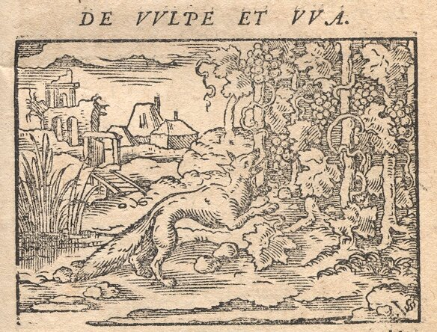
Examples of Fables

Slide 21
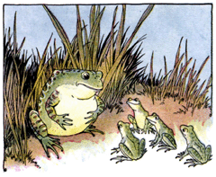
The Frog and the Ox
Hyperlink

Slide 22
A young frog, amazed at the huge size of an ox, rushed to tell her father about the monster. The father frog, trying to impress his child, puffed himself up to look like the ox. The young frog said it was much bigger. Again the father puffed himself up. The young frog insisted the monster was even bigger. The father puffed and puffed - and burst!

Slide 23
Moral of the Story
Be true to your own character

Slide 24
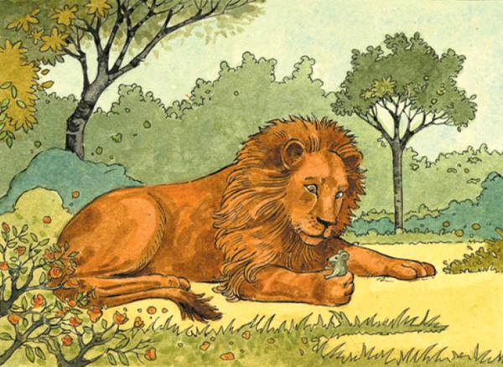
The Lion and the Mouse
Hyperlink

Slide 25
Once a lion trapped a mouse under its large paw. The mouse pleaded for its life, so the lion let it go. Later the lion became entangled in a hunter’s net and roared in distress. The mouse rushed to help. “You’re too small to help,” said the lion. But the mouse nibbled at the net until the lion was free.

Slide 26
Moral of the Story
Don’t forget: even the smallest friend is worthwhile

Slide 27
A Blacksmith and his Dog
Hyperlink

Slide 28
A Blacksmith had a little Dog, which used to sleep when his master was at work, but was very wide awake indeed when it was time for meals. One day his master pretended to be disgusted at this, and when he had thrown him a bone as usual, he said, "What on earth is the good of a lazy cur like you? When I am hammering away at my anvil, you just curl up and go to sleep: but no sooner do I stop for a mouthful of food than you wake up and wag your tail to be fed.”

Slide 29
Moral of the Story
Those who will not work deserve to starve

Slide 30
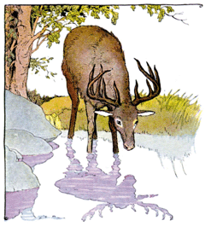
A Stag at the Pool
Hyperlink

Slide 31
A stag, gazing at his reflection in a pool, remarked, “What glorious antlers I have. But my legs are so skinny!” At that moment the stag heard a pack of hunters and hounds approaching. His long legs helped him flee into a thick wood, but his antlers became entangled in the branches. Struggle as he might, he was trapped - and the hounds and hunters closed in.

Slide 32
Moral of the Story
What is worth most is often valued least

Slide 33
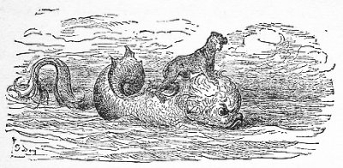
The Monkey and the Dolphin
Hyperlink

Slide 34
A monkey fell from a ship and was rescued by a dolphin. The dolphin asked if he lived nearby. The monkey lied and said that he did. “Do you know Seriphos?” asked the dolphin. The monkey, thinking Seriphos was a person’s name, boasted that it was his best friend. As Seriphos was a town, the dolphin knew the monkey was lying, so he dived, leaving him to swim to shore.

Slide 35
Moral of the Story
Those who lie and boast may end up in trouble

Slide 36
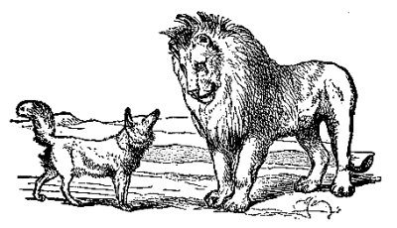
The Fox and the Old Lion
Hyperlink

Slide 37
An old lion sent out word that he was ill and said that he would like the animals and birds to visit him. Most went but fox did not. Finally the lion sent for him, asking why he had not come to see him. The wily fox replied, “I had planned to, but I noticed that although many tracks led into your cave, none led out.”

Slide 38
Moral of the Story
Take warning from the misfortunes of others.

Slide 39
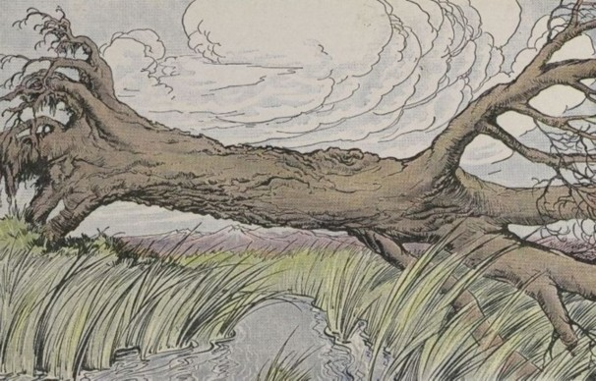
The Oak and the Reeds
Hyperlink

Slide 40
A very large oak was uprooted by the wind, and thrown across a stream. It fell among some Reeds, which it thus addressed: I wonder how you, who are so light and weak, are not entirely crushed by these strong winds. They replied: You fight and contend with the wind, and consequently you are destroyed; while we, on the contrary, bend before the least breath of air, and therefore remain unbroken.

Slide 41
Moral of the Story
Stoop to conquer

Slide 42
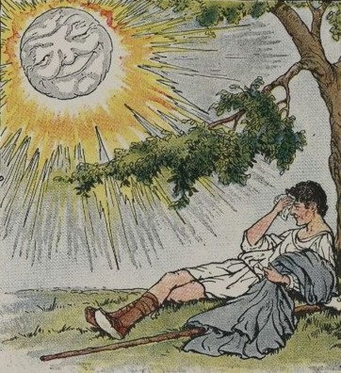
The Wind and the Sun
Hyperlink

Slide 43
The wind and the sun argued over who was the stronger. They saw a traveller and agreed that whoever could get the traveller’s coat off his body must be the stronger. The wind blew fiercely, but the harder it blew, the tighter the man clutched his coat. Then the sun beamed its warm rays until the man was so hot he took off his coat.

Slide 44
Moral of the Story
Kindness affects more than severity

Slide 45
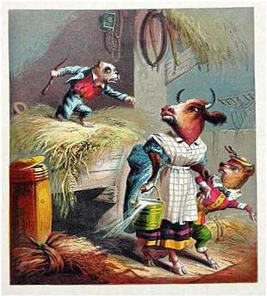
The Dog and the Manger
Hyperlink

Slide 46
A dog decided to nap in a manger full of fresh hay intended for the family ox. At the end of that long day, the tired ox returned to the stable to eat some of the hay in the manger, but the dog awoke and barked and bit so fiercely that the ox could not eat the hay. "You are mean and vicious," said the ox. "You don't eat hay, so why do you stop me from enjoying it?"

Slide 47
Moral of the Story
People often grudge others what they cannot enjoy themselves

